Slide 1
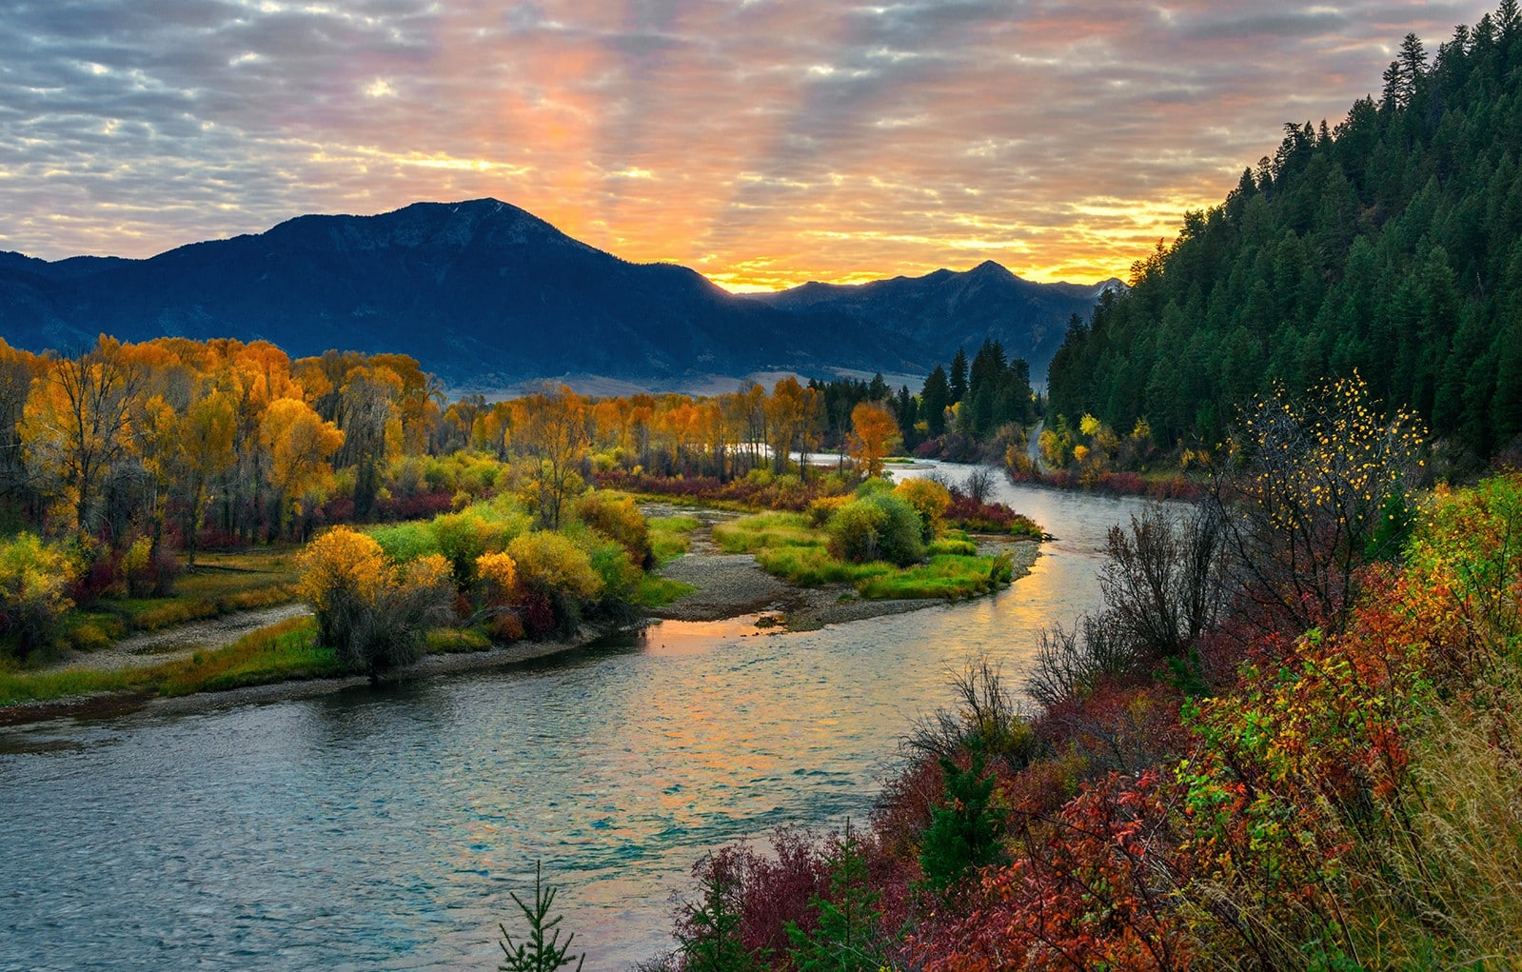
High Country Fly Fishers
2026 Annual Membership Report
& Trip Survey Report

Slide 2


LEADERSHIP
President: Eric Luna
Vice President/Conservation: Jayne Guyse
Secretary/Treasurer: Jack Reynotlds
Past President/Board Member: Bill Quapp
Board Member/Fly Tying: Todd Johnson
Board Member/Financial Review Officer/Donations: Katie Cannarella
Board Member/Membership: Gene Cannarella
Board Member/Clinics: Larry Finch
Senior Advisor/Youth Education: Harold "Bruce" Pope
Senior Advisor: John Schultz
Senior Advisor: Mike Leigh
Senior Advisor: Pat Ronneburg
Senior Advisor: Jack Campbell
Senior Advisor/Founder: Cal Massey

Slide 3
2025 Projects
Cleanups – Fish For Garbage
Clinics
Beginner Fly Tying
Beginner Fly Fishing
Youth Education
Boy Scouts Fishing
Park City Fishing Club
Trout in the Classroom
Casting for Recovery
Project Healing Waters Fly Fishing
Weber River Crossovers
Christmas Party
Steak Fry
Wasatch Expo

Slide 4
Trout in the Classroom
Trout in the Classroom (TIC) Trout in the Classroom teaches students the importance of water quality, responsibility of caring for natural resources, survival of the fittest, and fishing as an enjoyable hobby. Fertilized rainbow trout eggs are delivered to area schools, and the classes raise them fingerlings before releasing them into nearby waters with the aim of making a connection between caring for the fish and caring for the environment.
Program Overview:
Leader: Tom White (once again)
Reach: Six schools and approximately 338 students.
Current Status: Tanks were set up in October with dechlorinated water and established bacteria to ensure a healthy environment.
Volunteers Needed: While Bill and Cathe Quapp (Old Mill Elementary) and Tammy Finch (Parley’s Park) are already assisting, we need additional volunteers to support Tom.
Commitment: Less than one hour per week through early May.
Duties: Assist students with basic tank maintenance.

Slide 5
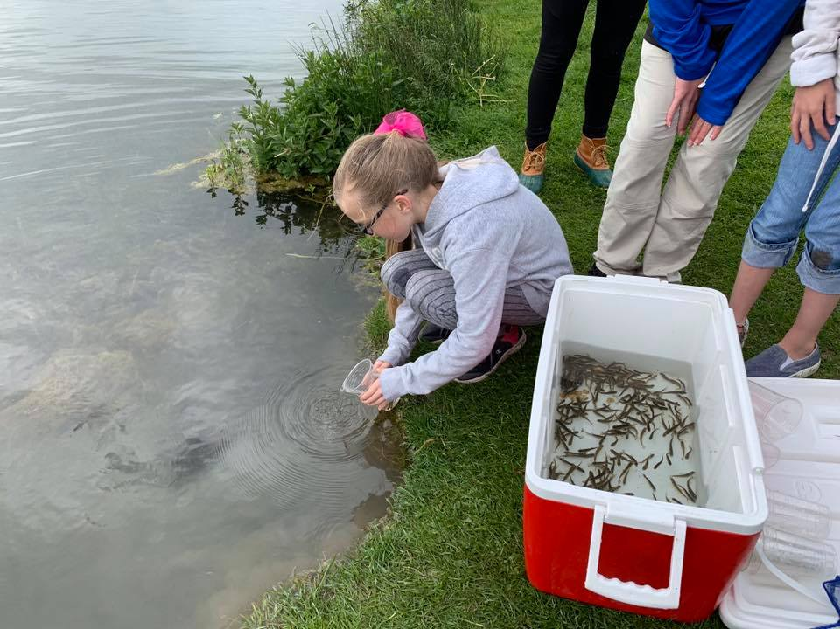
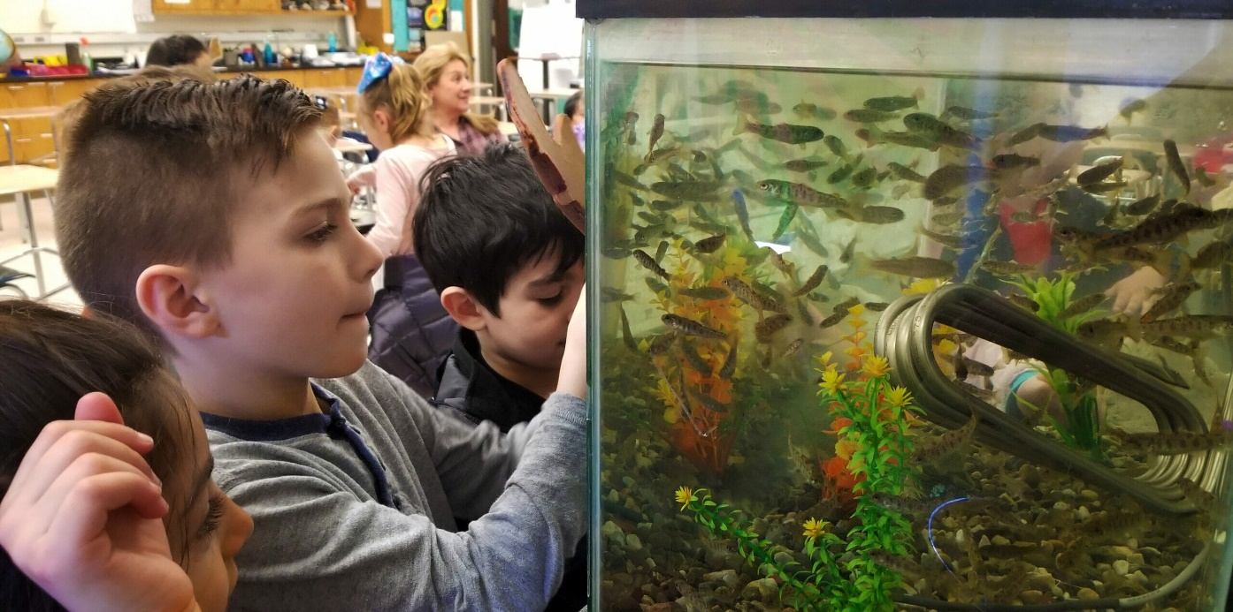
Trout in the Classroom

Slide 6
Speakers
If you have suggestions for speakers, please send us an email through the website or contact any board member.
Please include topic, contact information, and whether they will offer a trip or gear for us to raffle.

Slide 7
Treasurer’s Report
as of January 7, 2026
1. US Bank Checking Account $ 27,553
2. US Treasury Bills $35,000 ($150/mo)
3. First Internet Bank CD $ 11,215 ($29/mo)
4. Petty Cash $ 303.00
Total $73,768 (includes $10,000 Embrace-A-Stream restricted funds)
Significant Revenue:
2025 Expo share $5,490 - $5,000 went to capital contribution

Slide 8
Wasatch Expo
The Wasatch Fly Tying and Fly Fishing Expo returns April 10–11, 2026, following its premier Fundraising Banquet on Thursday, April 9, 2026. As the Expo's single largest source of revenue, the banquet is essential for funding local conservation and youth programs; we encourage everyone to attend and support these vital initiatives.
Leadership and Performance
Overall Responsibility: Eric Luna serves as the Expo President.
Marketing and Growth: Bill Quapp leads marketing efforts and was instrumental in increasing Net Operating Income (NOI) from $6,500 in 2024 to $26,000 in 2025.
Cashiers and Raffle Sales: Jen Stockett and Todd Johnson are there morning til night.
Organizational Structure: The event is a joint venture between six Trout Unlimited (TU) chapters and two Fly Fishers International (FFI) chapters.
Single Biggest Source of HCFF Revenues

Slide 9
Wasatch Expo
Utah Fly Fishing Hall of Fame
The Expo is the proud owner and founder of the Utah Fly Fishing Hall of Fame, which honors individuals who have made significant contributions to Utah's angling community. We are honored to recognize several High Country Fly Fishers members among its distinguished inductees:
Cal Massey (Founder of HCFF) Marty Howard
John Schultz Bob Dibblee
Pat Ronneburg
Event Highlights & Fundraising
Location: Mountain America Expo Center, Sandy, UT.
Exhibitors & Tyers: The event features 80+ vendors and over 50 expert fly tyers sharing their craft.
Workshops & Activities: Attendees have the opportunity to take educational workshops and participate in raffles and silent auctions held throughout the Expo.
Banquet Auctions: The Thursday night banquet features exclusive live and silent auctions alongside opportunity drawings (raffles) for high-end gear and custom fly boxes.
For more details on workshops or to purchase banquet tickets, please visit www.WasatchExpo.com.

Slide 10
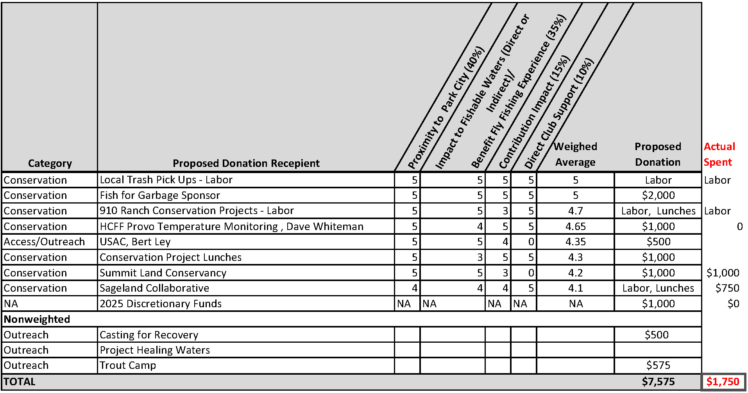
2026 Donations Plan

Slide 11
2025 Trips
April - Minersville
May - Starvation Reservoir/Strawberry River
June – Otter Creek (cancelled)
July – Boulder (cancelled)
August – Washington Lake
September - Strawberry Reservoir/Strawberry River
October - Island Park, ID

Slide 12
Flies & Lies Tying Social
Jack Campbell is starting a tying social gathering that will meet monthly at St. Mary’s Church on Saturdays beginning January 17. Beginners through experts are encouraged to join. It’s not a class or clinic per se; however, experts will assuredly generously share their knowledge.
The group will have lunch at Red Rock following the event.
If requested, we will make HCFF’s equipment available.
Even if you just come to watch and learn, all are encouraged to join in and socialize with their fellow members.

Slide 13
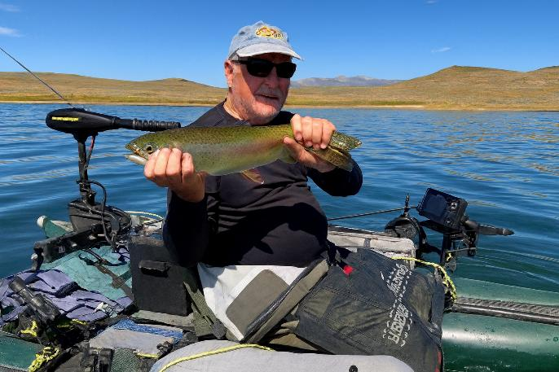
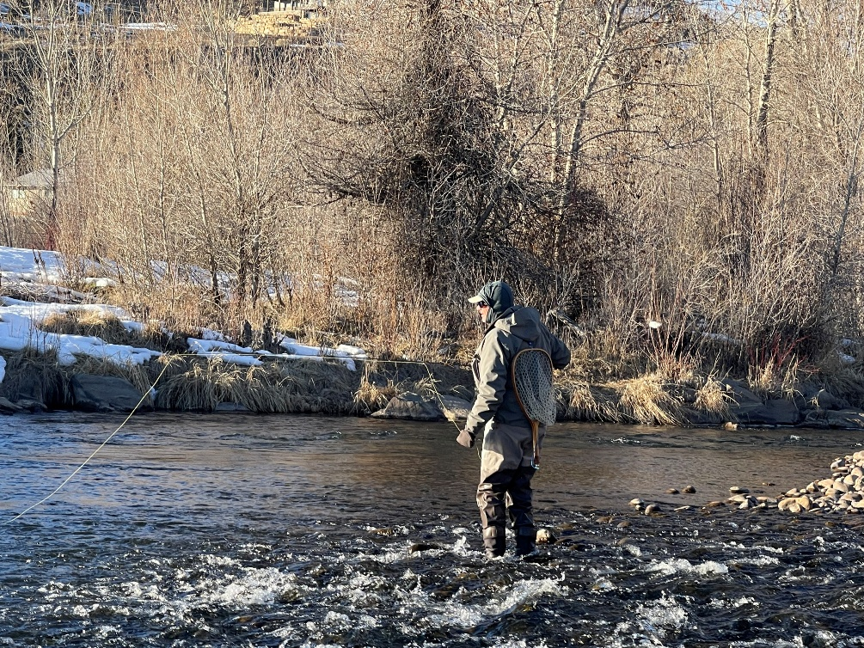
2026 Proposed Trips
HCFF 2026 Trips Planning Survey Results January 2026 Annual Membership Meeting
Compiled by Jayne Guyse, HCFF Vice President
Presented by Pat Ronneburg, Board Member and Senior Advisor
January 2026

Slide 14
Approach for Selecting HCFF’s 2026 Trips
Gathered ideas from membership
Requested suggestions in October HCFF Newsletter
November Meeting to collect ideas from membership
Reviewed destination suggestions for fishability and timing for best fishing
Created an “HCFF Members” list
TU members assigned to HCFF by zip code; many are not active in HCFF … yet!
Those who’ve made Annual Donation, participated in a clinic, or purchased anything
Thanks to John Atwood/HCFF Webmaster for the members list!
Surveyed Members
Destination options organized by month
Distributed survey link to 300+ members
Received approximately 63 responses by December 28, 2025
Thank you to all who completed the survey!

Slide 15
Survey Results: Trip Planning Selections
January Day Trip: Freeze Your A** Off on the Middle Provo on January 10th; combined outing with Bonneville Fly Fishers organizing across local clubs
February Day Trip: Middle Provo for buffalo midge hatch in late February (TBD) [Safari Leader Pat Ronneburg]
March
Day Trip: Sportsman’s Paradise (a.k.a. White’s Ranch) in March (TBD based on ranch availability) with limit of ~20 fishers [Safari Leader Jayne Guyse]
Overnight Trip: Otter Creek and Kingston Canyon near Beaver, UT; date is TBD [Safari Leaders needed for Stillwater and Walk & Wade]
April
Day Trip: Strawberry Reservoir when ice has pulled back ~15’; optimal ice conditions are likely mid-April, maybe [Safari Leaders Pat Ronneburg and Jayne Guyse]
Overnight Trip: Minersville Reservoir, Beaver River below Minersville (depending on irrigation flows), the Beaver River and lakes above the town (depending on snow pack), and other area creeks [Safari Leader Bill Quapp; Pat Ronneburg and Jayne Guyse will lead Walk & Wade]

Slide 16
Survey Results: Trip Planning Selections (con’t)
May Day & Overnight Trip Combo: Starvation Reservoir, Duchesne River at The Oasis, Stillwater Ponds at Rock Creek below Upper Stillwater Reservoir, and possibly Lake Canyon Lake; May 13th – 17th [Safari Leader is Bill Quapp for Stillwater; leader needed for Walk & Wade]
June
Day Trip: The Duchesne River and Mill Hollow Reservoir near Hanna, UT; this trip will have a maximum number of fishers; dates TBD [Safari Leaders needed for both Stillwater and Walk & Wade]
Overnight Trip: Six Lakes Resort in Altamont, UT; cost and dates dependent on date & availability [Safari Leaders Todd Johnson and Jen Stockett]

Slide 17
Survey Results: Trip Planning Selections (con’t)
July
Day Trip: Little Dell Reservoir near SLC; date TBD after reservoir opens for fishing [Safari Leaders needed for Stillwater; Jayne Guyse leads Walk & Wade]
Overnight Trip: Learn to Wade the Green River at Dutch John, UT; July 31st -August 4th. Trip attendance is limited by the volunteers needed to help new fishers. [Safari Leaders needed for Stillwater; Jack Campbell leads Walk & Wade]
August
Day Trip: Washington Lake in the Uintas; date TBD [Safari Leaders Todd Johnson & Jen Stockett]
Overnight Trip: The Snake River, Greys and Little Greys Rivers, Salt River, Palisades Reservoir and Jackson Lake near Alpine, WY; dates TBD [Safari Leader is Kevin Parsons; co-lead needed who will attend the trip]

Slide 18
Survey Results: Trip Planning Selections (con’t)
September (slight deviation from survey vote)
Day & Overnight Combo Trip: Strawberry Reservoir for big cuts from boats and bank, Sept 9 - 14 [Safari Leader Bill Quapp for Stillwater; leader needed for Walk & Wade]
Day & Overnight Combo Trip: Huntington Lake, Mammoth Lake, Electric Lake, Miller Flat Reservoir, Gooseberry Reservoir, Scofield Reservoir for still water; and, the South Fork, Left Fork and main stem of Huntington Creek for moving water near Price, UT; date TBD [Safari Leaders needed for Stillwater and Walk & Wade]
October (slight deviation from survey vote)
Day Trip: Middle Provo for rainbows coming out of Deer Creek Reservoir for spawning browns’ eggs; date TBD [Safari Leaders needed for Walk & Wade]
Overnight Trip: Island Park, ID and Yellowstone Nat’l Park; October 8th – 12th [Safari Leader Eric Luna]

Slide 19
APPENDIX: Survey Results Details Charts & Data by Survey Monkey

Slide 20
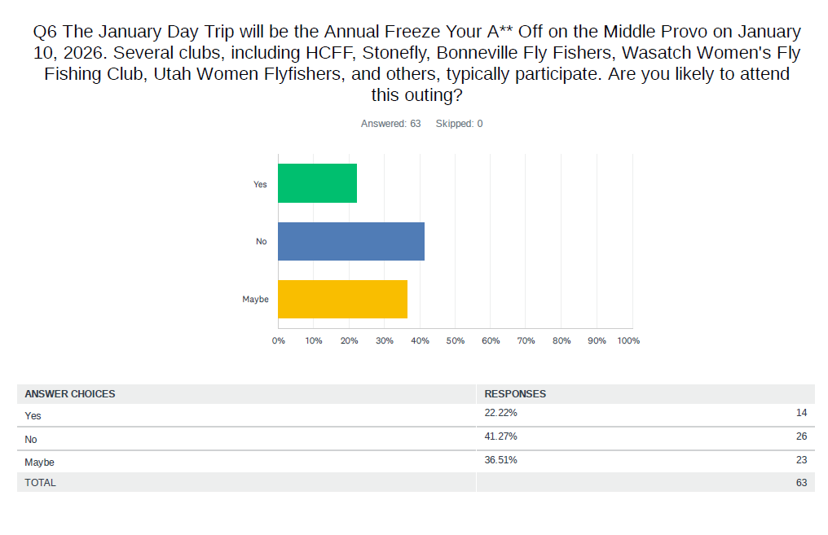
Data Analysis: January Day Trip/Annual Freeze Your A** Off

Slide 21
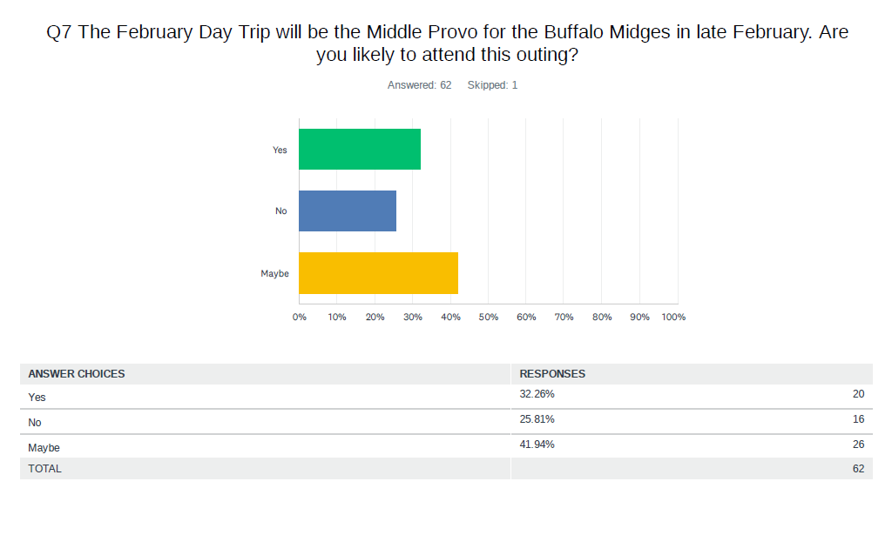
Data Analysis: February Day Trip

Slide 22
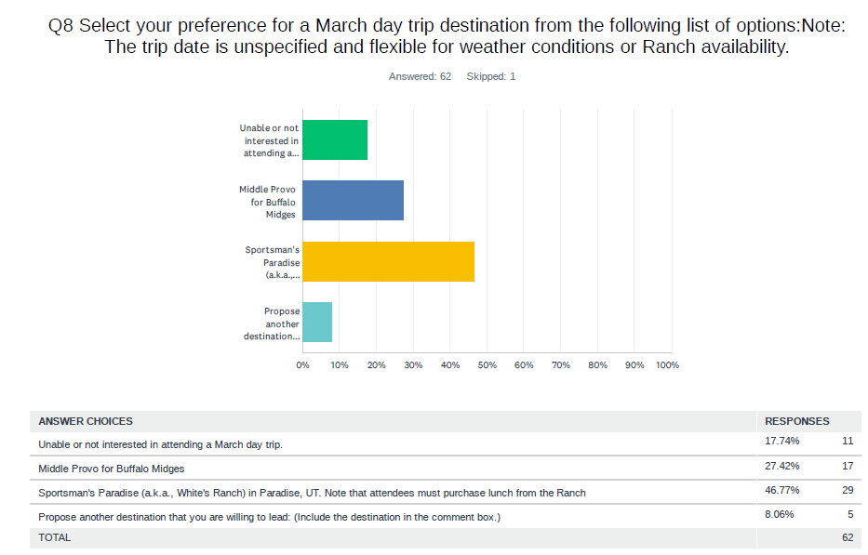
Data Analysis: March Day Trip

Slide 23
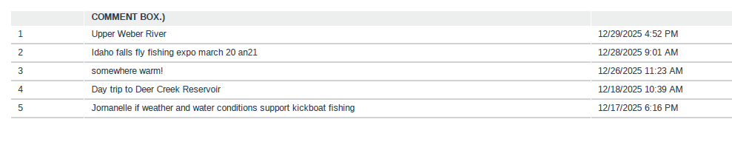
Data Analysis: March Day Trip (con’t)
The following destinations were proposed as alternates to those offered for the March Day Trip. We will hold onto these suggestions in the event we need an alternate trip in 2026; we will also include these destinations in the 2027 Trips Survey.

Slide 24
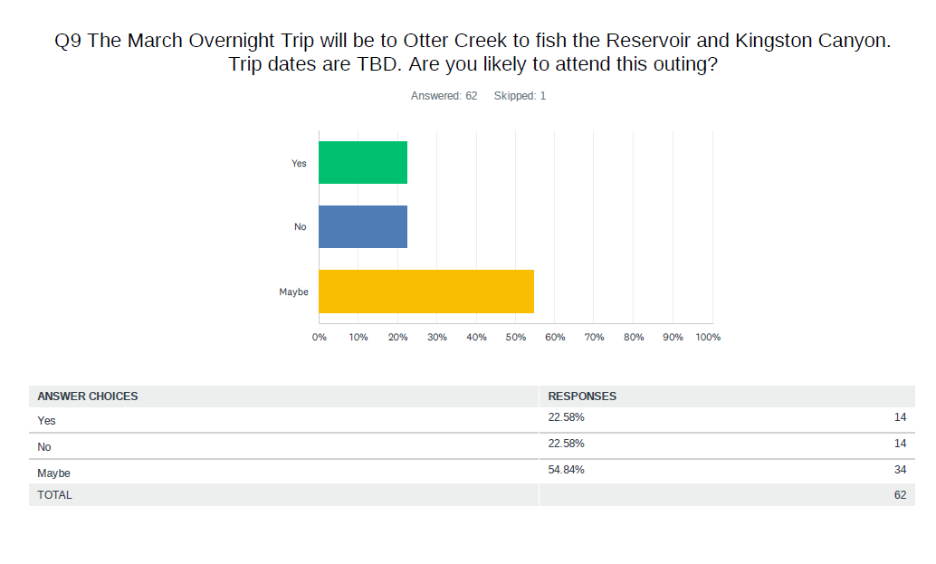
Data Analysis: March Overnight Trip

Slide 25
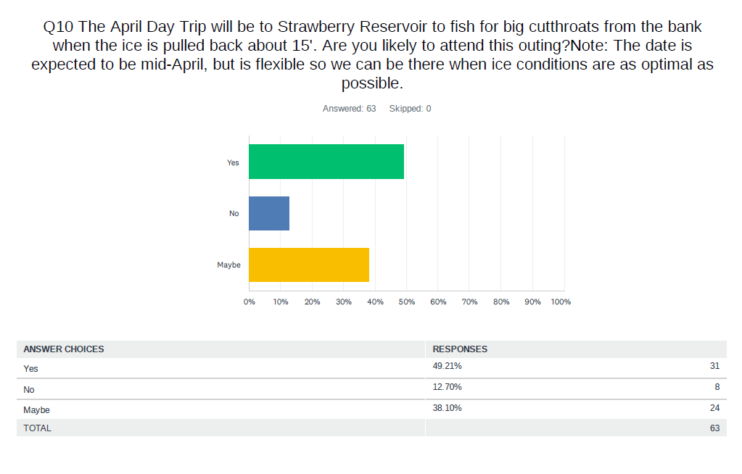
Data Analysis: April Day Trip

Slide 26
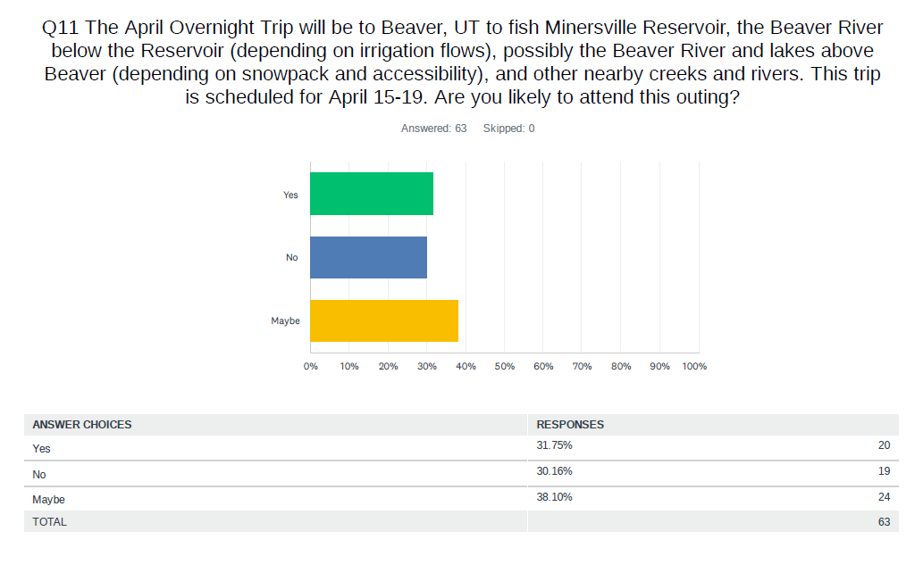
Data Analysis: April Overnight Trip

Slide 27
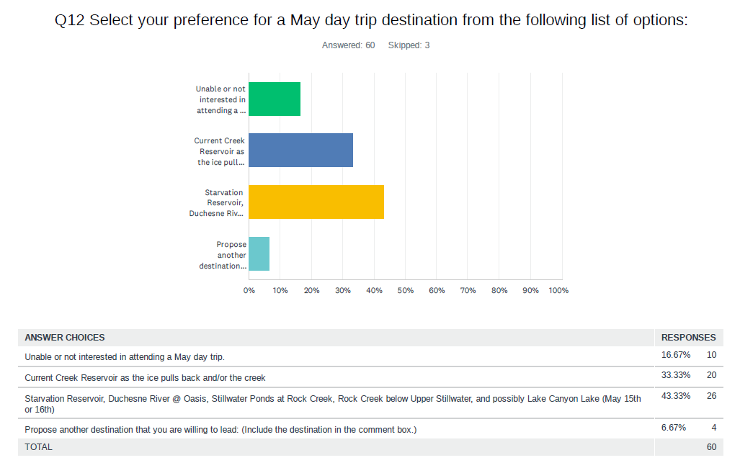
Data Analysis: May Day Trip

Slide 28
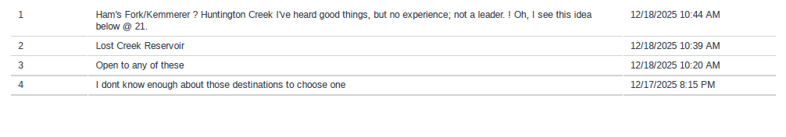
Data Analysis: May Day Trip (con’t)
The following destinations were proposed as alternates to those offered for the May Day Trip. We will hold onto these suggestions in the event we need an alternate trip in 2026; we will also include these destinations in the 2027 Trips Survey.

Slide 29
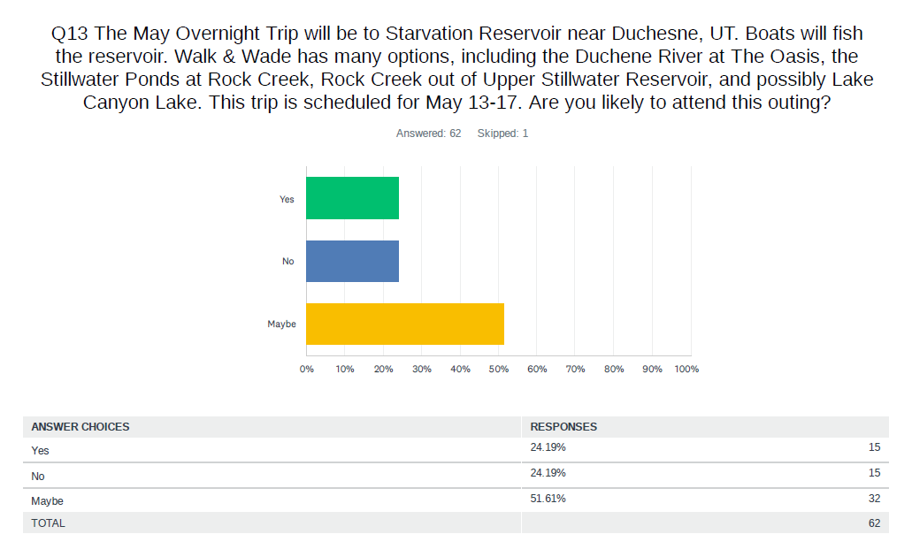
Data Analysis: May Overnight Trip

Slide 30
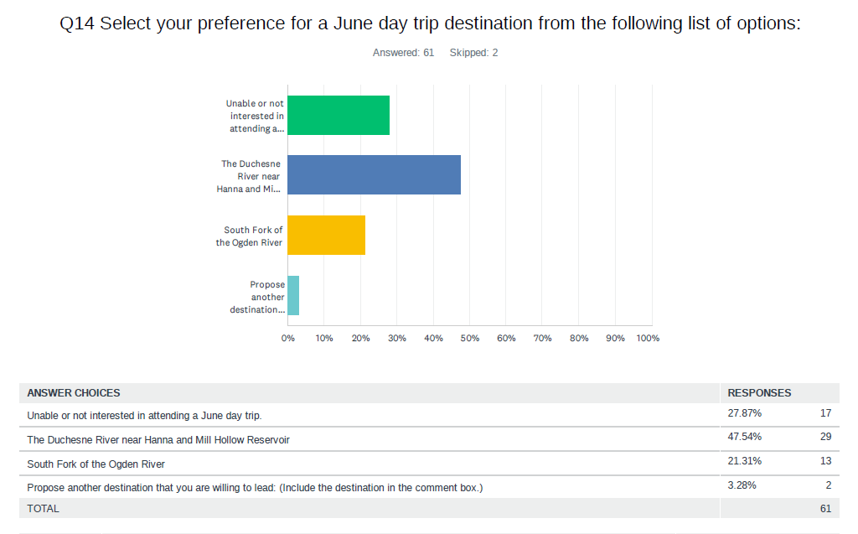
Data Analysis: June Day Trip

Slide 31
Data Analysis: June Day Trip (con’t)
The following destinations were proposed as alternates to those offered for the June Day Trip. We will hold onto these suggestions in the event we need an alternate trip in 2026; we will also include these destinations in the 2027 Trips Survey.

Slide 32
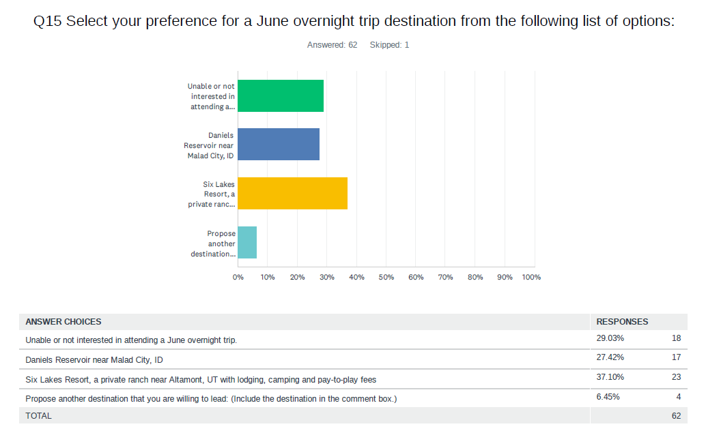
Data Analysis: June Overnight Trip

Slide 33
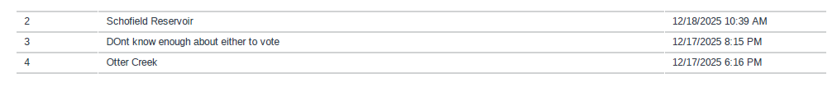
Data Analysis: June Overnight Trip (con’t)
The following destinations were proposed as alternates to those offered for the June Overnight Trip. We will hold onto these suggestions in the event we need an alternate trip in 2026; we will also include these destinations in the 2027 Trips Survey.

Slide 34
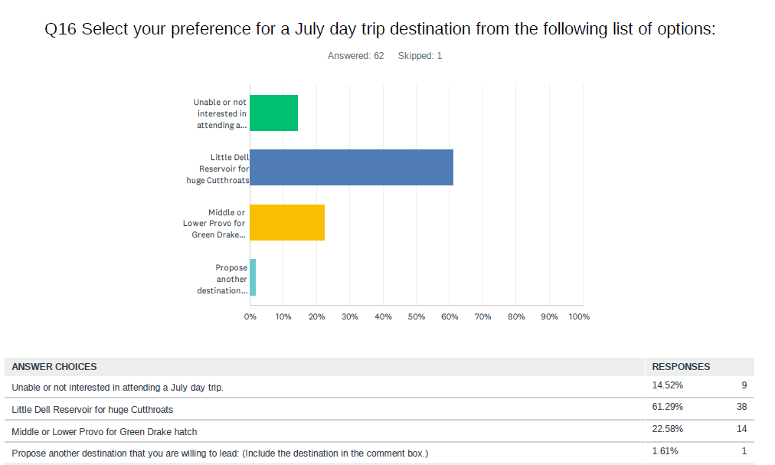
Data Analysis: July Day Trip

Slide 35
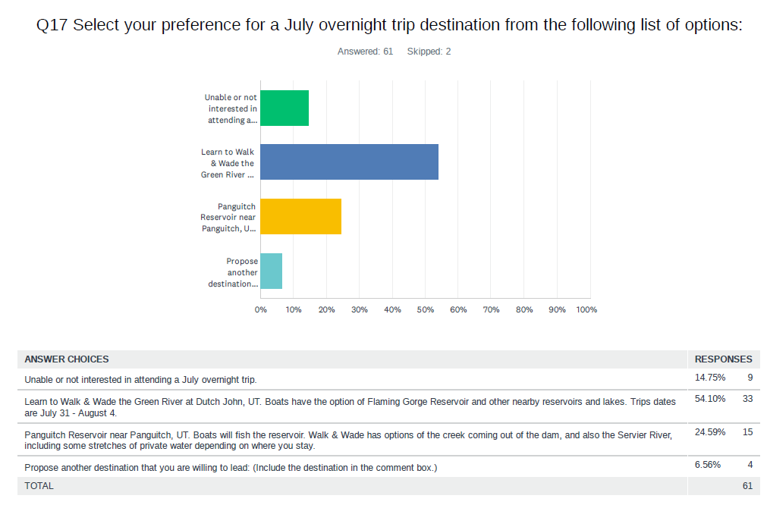
Data Analysis: July Overnight Trip

Slide 36
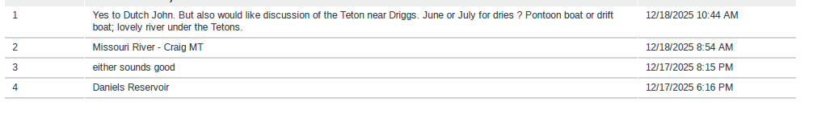
Data Analysis: July Overnight Trip (con’t)
The following destinations were proposed as alternates to those offered for the July Overnight Trip. We will hold onto these suggestions in the event we need an alternate trip in 2026; we will also include these destinations in the 2027 Trips Survey.

Slide 37
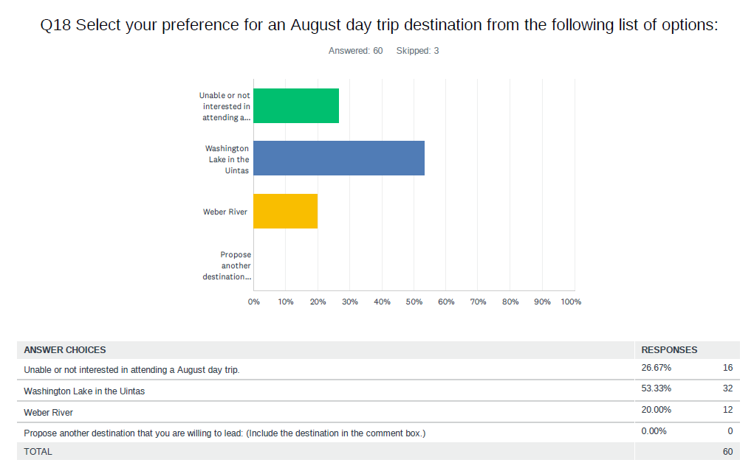
Data Analysis: August Day Trip

Slide 38
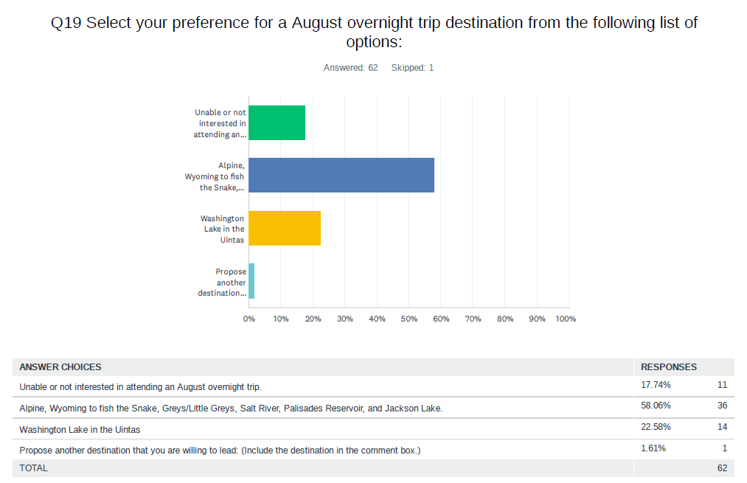
Data Analysis: August Overnight Trip
Kevin Parsons will lead the Alpine trip, but will need a co-leader, as he will not be able to attend due to a conflicting family trip. He’s fished many places in the area and will share knowledge for novices on where to try and flies to use

Slide 39
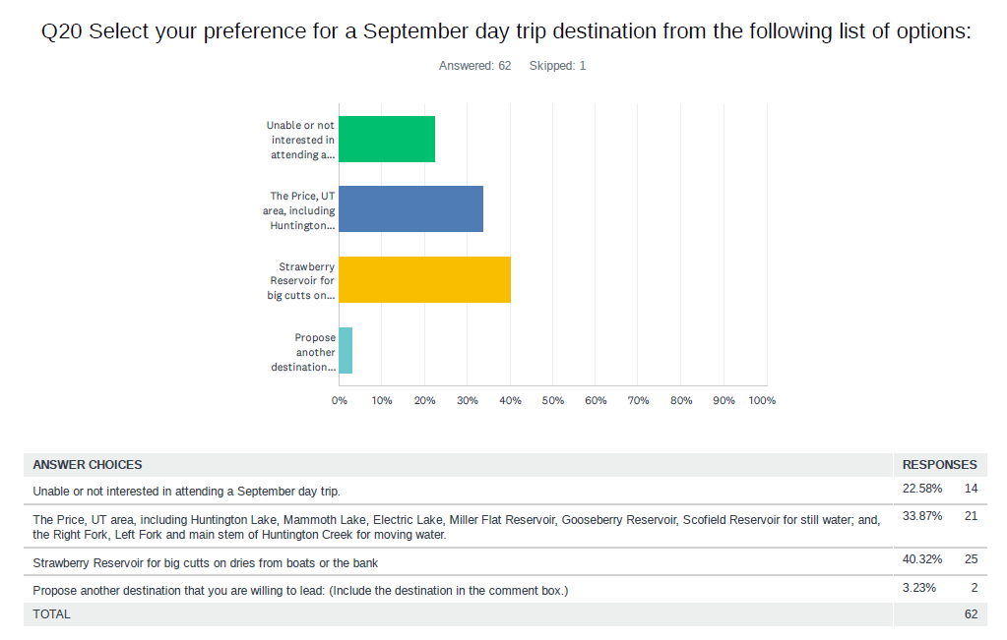
Data Analysis: September Day Trip

Slide 40
Data Analysis: September Day Trip (con’t)
The following destinations were proposed as alternates to those offered for the September Day Trip. We will hold onto these suggestions in the event we need an alternate trip in 2026; we will also include these destinations in the 2027 Trips Survey.

Slide 41
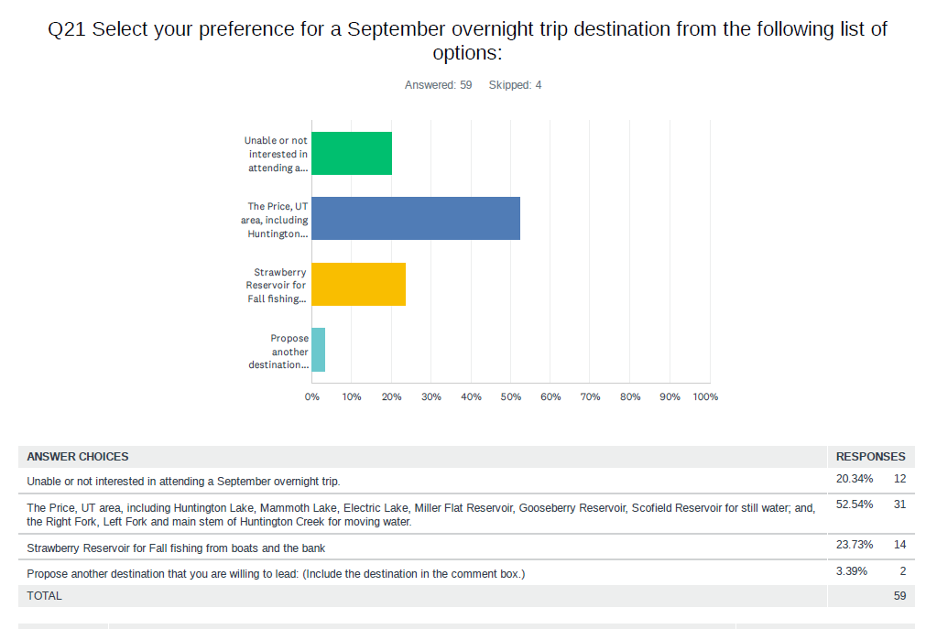
Data Analysis: September Overnight Trip

Slide 42
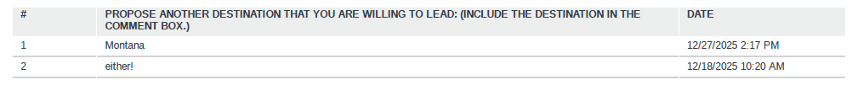
Data Analysis: September Overnight Trip (con’t)
The following destinations were proposed as alternates to those offered for the September Overnight Trip.

Slide 43
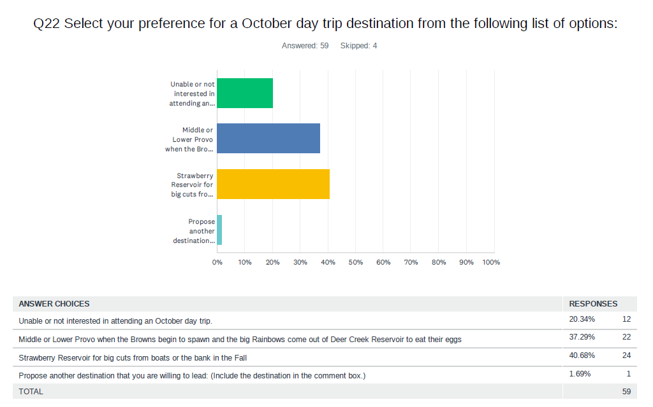
Data Analysis: October Day Trip

Slide 44
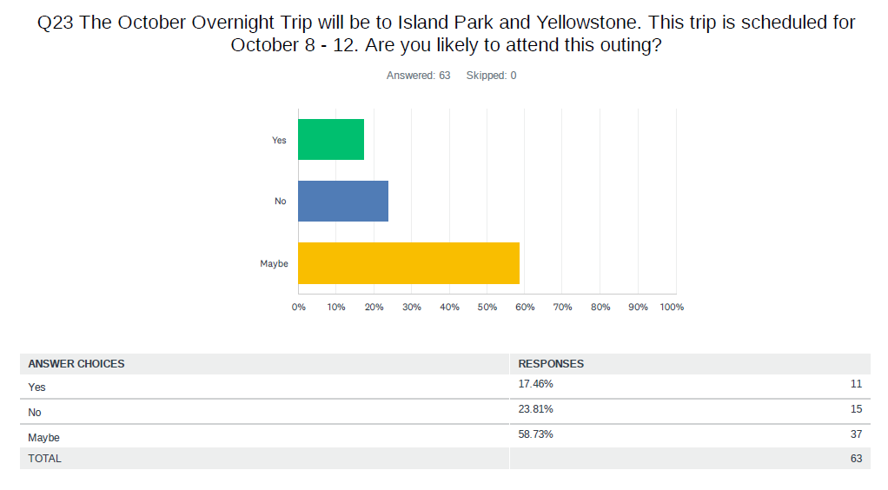
Data Analysis: October Overnight Trip

Slide 45
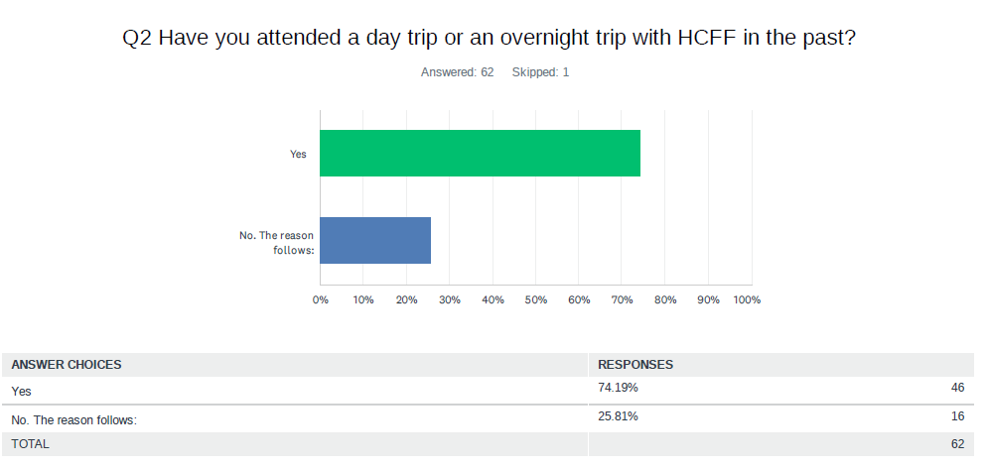
Data Analysis: Trip Attendance

Slide 46
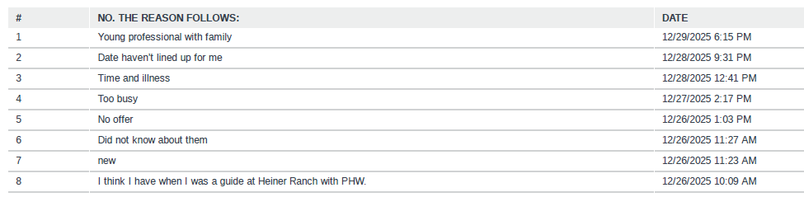
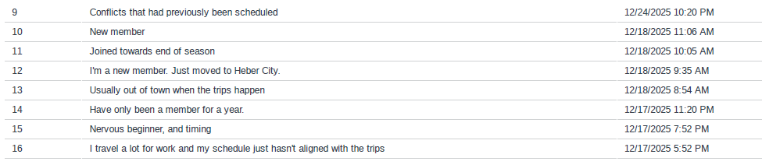
Data Analysis: Trip Attendance (con’t)

Slide 47
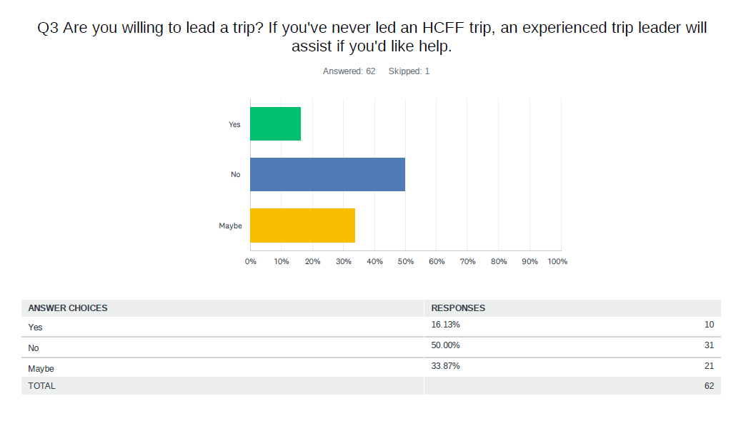
Data Analysis: Seeking Safari Leaders Question

Slide 48
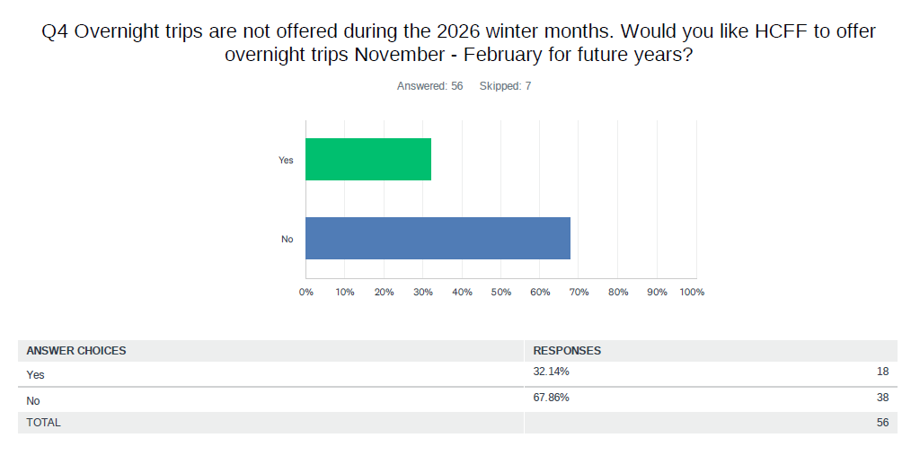
Data Analysis: Winter Month’s Trips

Slide 49
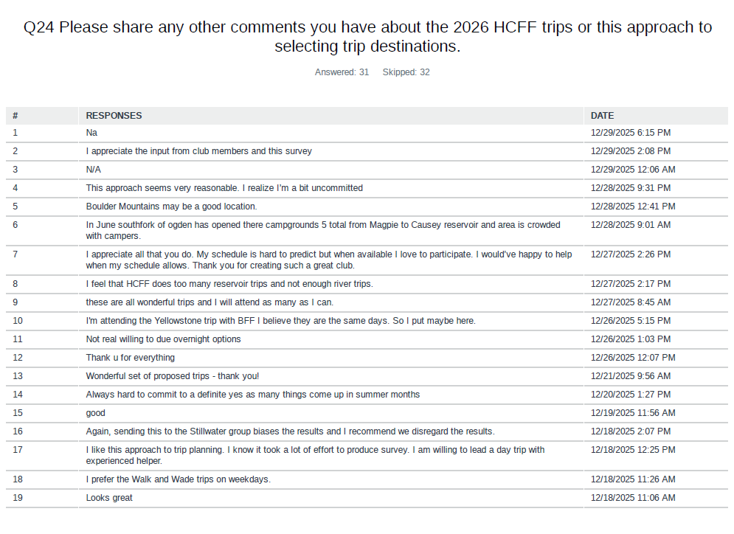
Data Analysis: Thoughts on Survey Approach to Trips

Slide 50
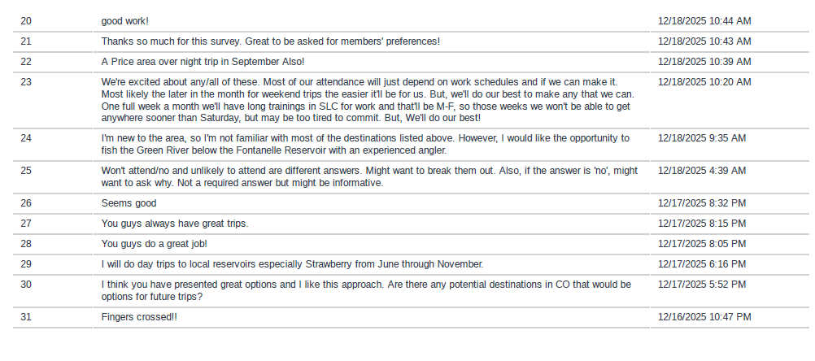
Data Analysis: Thoughts on Survey Approach to Trips (con’t)

Slide 51
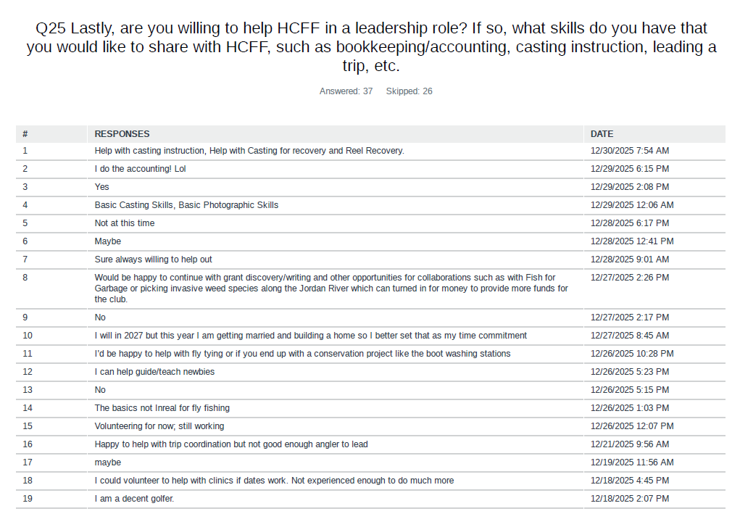
Data Analysis: Willingness to Help and Skills

Slide 52
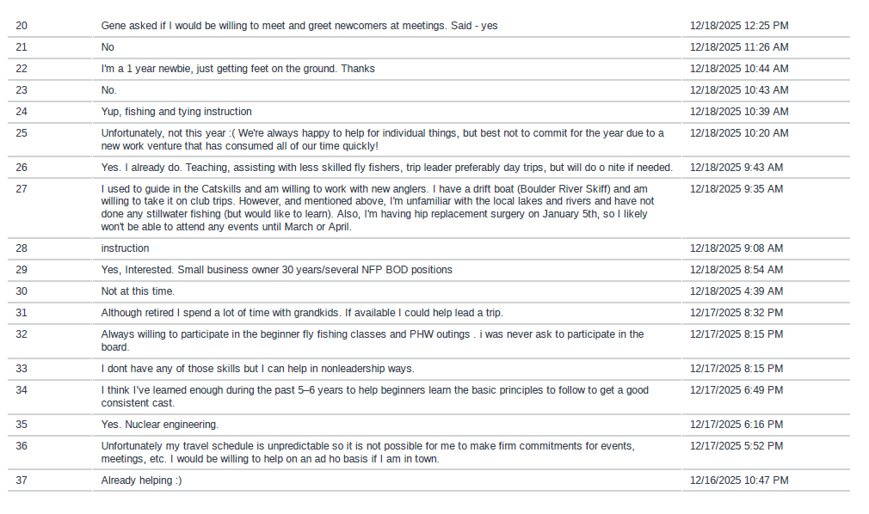
Data Analysis: Willingness to Help and Skills (con’t)

